Slide 1
International Directorate Structure
Roles and Responsibilities
&
International Committees and Chairmen
Dr. Glenda Glover, International President & CEO
Mary B. Conner, Chairman Kathy A. Walker Steele, Co-Chairman
International Chapter Basileus Certification Committee

Slide 2
International Directorate Structure
Roles and Responsibilities

Slide 3
THE DIRECTORATE
The Directorate is comprised of the Supreme Basileus, 1st Supreme Anti-Basileus, 2nd Supreme Anti-Basileus, Supreme Grammateus, Supreme Tamiouchos, Supreme Parliamentarian, two Undergraduate Members-At-Large and ten Regional Directors.
The Directorate has the power to carry on the business of Alpha Kappa Alpha when the Boule is not in session. Duties include hearing and acting upon appeals, making recommendations to the Boule and submitting for circulation proposed amendments to the Constitution and Bylaws.

Slide 4
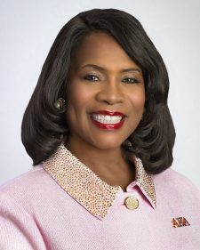
SUPREME BASILEUS
She shall preside at all meetings of the Boule and the Directorate. She shall perform the duties which are usually executed by the chief officer. She shall appoint, with the approval of the Directorate all delegates to the national organizations with which Alpha Kappa Alpha Sorority, Incorporated, is affiliated. She shall exercise general supervision over employed personnel and over the Boule. The program of the Boule shall be prepared under her direction. She shall be an ex-officio member of all committees except the Nominating Committee.
Dr. Glenda Glover
Beta Delta Omega
Nashville, TN
Notes:
Read the name, title and description.

Slide 5
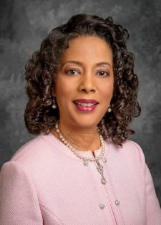
1st SUPREME ANTI-BASILEUS
It shall be the duty of the First Supreme Anti- Basileus to assist the Supreme Basileus in the performance of her duties and to preside during the absence of the Supreme Basileus.
Danette Anthony Reed
Omicron Mu Omega Carrollton, TX

Slide 6
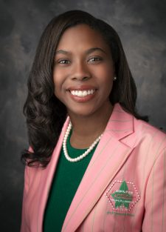
2nd SUPREME ANTI-BASILEUS
It shall be the duty of the Second Supreme Anti-Basileus to assist the Supreme Basileus in the performance of her duties. She shall be Chairman of the Undergraduate Activities Committee and a member of the Program Committee and Finance Committee.
Jasmyne E. McCoy
Lambda Upsilon
Cambridge, MA

Slide 7
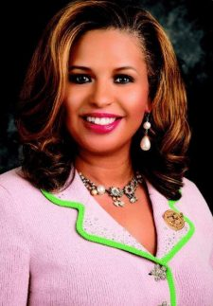
SUPREME GRAMMATEUS
It shall be the duty of the Supreme Grammateus to be secretary of the Boule, Directorate and Constitution Committee. She shall be a member of the Constitution Committee.
Chelle Luper Wilson
Tau Rho Omega
Frisco, TX

Slide 8
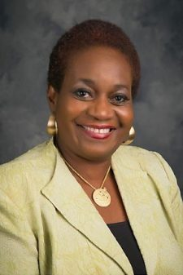
SUPREME TAMIOUCHOS
It shall be the duty of the Supreme Tamiouchos to monitor all receipts and expenditures of the Sorority from the Alpha Kappa Alpha Corporate Office. She shall make periodic reports in writing on the finances of the Sorority. She shall be Chairman of the Finance Committee and present the budget of estimated income and expenditures to the Boule for approval.
Gayle Miles-Scott
Beta Sigma Omega
Oklahoma City, OK

Slide 9
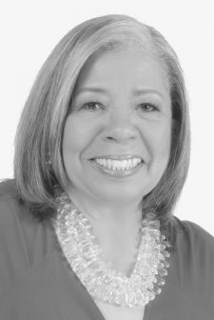
SUPREME PARLIAMENTARIAN
It shall be the duty of the Parliamentarian to advise the presiding officer in the interpretation of the Constitution and Bylaws of Alpha Kappa Alpha Sorority, incorporated and Robert’s Rules of Order Newly Revised – 12th Edition. She shall be Chairman of the Constitution Committee.
Bonnie Murdah
Rho Theta Omega Philadelphia, PA

Slide 10
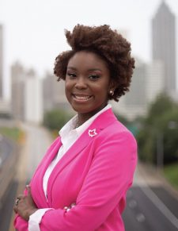
UNDERGRADUATE MEMBER-AT-LARGE
It shall be the duty of each Undergraduate Member-At-Large to serve as a member of the Undergraduate Activities Committee and to assist the Second Supreme Anti-Basileus in designing, developing, coordinating and promoting the Alpha Kappa Alpha Program among undergraduate chapters.
Alysse Guerrier
Eta Iota
Columbus, GA

Slide 11
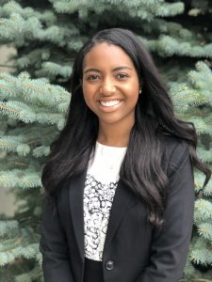
UNDERGRADUATE MEMBER-AT-LARGE
It shall be the duty of each Undergraduate Member-At-Large to serve as a member of the Undergraduate Activities Committee and to assist the Second Supreme Anti-Basileus in designing, developing, coordinating and promoting the Alpha Kappa Alpha Program among undergraduate chapters.
Jasmine Williams
Beta Eta
Ann Arbor, MI

Slide 12
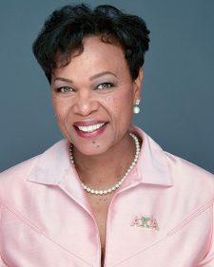
NORTH ATLANTIC
REGIONAL DIRECTOR
It shall be her duty to exercise general supervision over the chapters of the North Atlantic Region. She shall have the power to address problems in her region. She shall notify chapters when candidates have been approved for the Membership Intake process. She shall preside over the Regional Conferences and other regional meetings, e.g. Cluster Meetings, Retreats and Roundups. She shall have responsibility for the establishment of chapters in the region.
Mary Lamar Bentley
Omicron Xi Omega
Newark, NJ

Slide 13
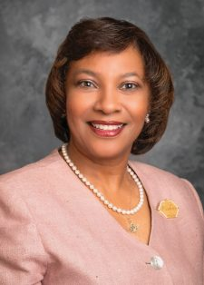
MID ATLANTIC
REGIONAL DIRECTOR
It shall be her duty to exercise general supervision over the chapters of the Mid Atlantic Region. She shall have the power to address problems in her region. She shall notify chapters when candidates have been approved for the Membership Intake process. She shall preside over the Regional Conferences and other regional meetings, e.g. Cluster Meetings, Retreats and Roundups. She shall have responsibility for the establishment of chapters in the region.
Jennifer King Congleton
Iota Kappa Omega
Winterville, NC

Slide 14
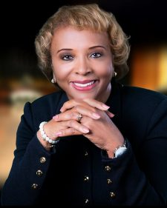
SOUTH ATLANTIC
REGIONAL DIRECTOR
It shall be her duty to exercise general supervision over the chapters of the South Atlantic Region. She shall have the power to address problems in her region. She shall notify chapters when candidates have been approved for the Membership Intake process. She shall preside over the Regional Conferences and other regional meetings, e.g. Cluster Meetings, Retreats and Roundups. She shall have responsibility for the establishment of chapters in the region.
Carolyn Randolph
Gamma Tau Omega
Midland, GA

Slide 15
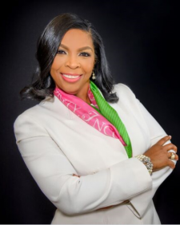
GREAT LAKES
REGIONAL DIRECTOR
It shall be her duty to exercise general supervision over the chapters of the Great Lakes Region. She shall have the power to address problems in her region. She shall notify chapters when candidates have been approved for the Membership Intake process. She shall preside over the Regional Conferences and other regional meetings, e.g. Cluster Meetings, Retreats and Roundups. She shall have responsibility for the establishment of chapters in the region.
Carrie Clark
Lambda Pi Omega
Rochester Hills, MI

Slide 16
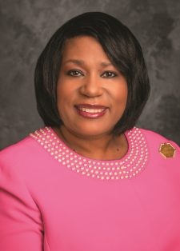
SOUTH EASTERN
REGIONAL DIRECTOR
It shall be her duty to exercise general supervision over the chapters of the South Eastern Region. She shall have the power to address problems in her region. She shall notify chapters when candidates have been approved for the Membership Intake process. She shall preside over the Regional Conferences and other regional meetings, e.g. Cluster Meetings, Retreats and Roundups. She shall have responsibility for the establishment of chapters in the region.
Mitzi Dease Paige
Beta Delta Omega
Jackson, MS

Slide 17
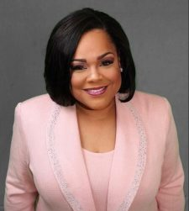
SOUTH CENTRAL
REGIONAL DIRECTOR
It shall be her duty to exercise general supervision over the chapters of the South Central Region. She shall have the power to address problems in her region. She shall notify chapters when candidates have been approved for the Membership Intake process. She shall preside over the Regional Conferences and other regional meetings, e.g. Cluster Meetings, Retreats and Roundups. She shall have responsibility for the establishment of chapters in the region.
Joya Hayes
Beta Psi Omega
Austin, TX

Slide 18
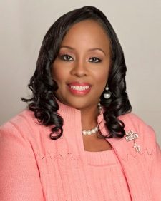
CENTRAL
REGIONAL DIRECTOR
It shall be her duty to exercise general supervision over the chapters of the Central Region. She shall have the power to address problems in her region. She shall notify chapters when candidates have been approved for the Membership Intake process. She shall preside over the Regional Conferences and other regional meetings, e.g. Cluster Meetings, Retreats and Roundups. She shall have responsibility for the establishment of chapters in the region.
Sonya L. Bowen
Lambda Tau Omega
Richton Park, IL

Slide 19
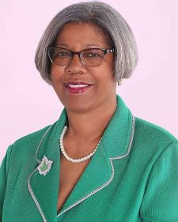
MID WESTERN
REGIONAL DIRECTOR
It shall be her duty to exercise general supervision over the chapters of the Mid Western Region. She shall have the power to address problems in her region. She shall notify chapters when candidates have been approved for the Membership Intake process. She shall preside over the Regional Conferences and other regional meetings, e.g. Cluster Meetings, Retreats and Roundups. She shall have responsibility for the establishment of chapters in the region.
Twyla Woods-Buford
Beta Omega
Kansas City, MO

Slide 20
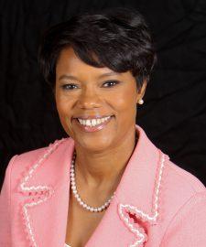
FAR WESTERN
REGIONAL DIRECTOR
It shall be her duty to exercise general supervision over the chapters of the Far Western Region. She shall have the power to address problems in her region. She shall notify chapters when candidates have been approved for the Membership Intake process. She shall preside over the Regional Conferences and other regional meetings, e.g. Cluster Meetings, Retreats and Roundups. She shall have responsibility for the establishment of chapters in the region.
Shelby D. Boagni
Alpha Gamma Omega
Los Angeles, CA

Slide 21
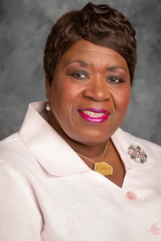
INTERNATIONAL
REGIONAL DIRECTOR
It shall be her duty to exercise general supervision over the chapters of the International Region. She shall have the power to address problems in her region. She shall notify chapters when candidates have been approved for the Membership Intake process. She shall preside over the Regional Conferences and other regional meetings, e.g. Cluster Meetings, Retreats and Roundups.
Joy Elaine Daley
Eta Omega Omega
Newburgh, NY

Slide 22
International Committees and Chairmen
(Alphabetical Order by Committee Name)

Slide 23
Delawne W. Quinn
General Member
Olive Branch, MS
CHAIRMAN
AMENITIES / COURTESIES COMMITTEE
This committee will assist the Supreme Basileus in providing courtesies as directed
Mary E. Wilson
General Member
Richmond, VA
CO-CHAIRMAN
Notes:
Read the name of the Chairman and Co-Chairman, the name of the committee and the roles and responsibilities.

Slide 24
ARCHIVES COMMITTEE
The committee has the responsibility for serving as the custodian of the Sorority’s print and non-print materials housed on the campus of Howard University and in the Corporate Office. It shall serve as advisor to Alpha Kappa Alpha in the development and implementation of policy for archival records.
Sonja W. Garcia
Alpha Alpha Theta Omega Chapter Tampa, FL
CHAIRMAN

Slide 25
BUILDING AND PROPERTIES COMMITTEE
It is the responsibility of this committee to oversee building and properties within Alpha Kappa Alpha Sorority, Incorporated.
Patricia Booth Magee
Rho Lambda Omega Chapter Jackson, MS
CHAIRMAN

Slide 26
Mary B. Conner
Kappa Lambda Omega Nashville, TN
CHAIRMAN
CHAPTER BASILEI
CERTIFICATION COMMITTEE
This committee has responsibility for training and certifying sorors
currently serving in the position of Chapter Basileus and those
interested in becoming a Chapter Basileus.
Kathy A. Walker-Steele
Delta Delta Omega
Belleville, IL
CO-CHAIRMAN

Slide 27
CHAPTER HISTORY BOOK PROJECT COMMITTEE
This committee will coordinate the publication of a chapter history book.
Lauren N. Peebles
Xi Gamma Omega Chapter
Oakland, CA
CHAIRMAN

Slide 28
CONFERENCE PLANNING COMMITTEE
This committee will assist in the planning of international and regional conferences.
Mona M. Hudson
Alpha Xi Omega Chapter
Dallas, TX
CHAIRMAN

Slide 29
Kamala D. Harris
VICE PRESIDENT OF THE UNITED STATES
CONGRESSIONAL WOMEN’S ROUNDTABLE
This committee will serve as an advisory group to the Supreme Basileus on legislative and social action issues that are of importance to Alpha Kappa Alpha Sorority, Incorporated.
Alma Adams
Rep. Alma Adams (D-NC-12), Chairman
CHAIRMAN

Slide 30
CONNECTION COMMITTEE
This committee shall identify and study national issues which impact the quality of life; design strategies with the membership
regarding these issues and mobilize the membership for action to formulate and recommend position statements to the Supreme Basileus and the Directorate.
Roslyn M. Brock
General Member Elkridge, MD
CHAIRMAN

Slide 31
CONSTITUTION COMMITTEE
This committee shall propose needed changes in the Constitution and Bylaws, carefully examine all proposed amendments from approved sources and formulate same to be circulated.
Bonnie Washington Murdah
Rho Theta Omega Chapter
Philadelphia, PA
CHAIRMAN

Slide 32
Chiquita V. White
Phi Psi Omega Chapter
Forest Park, OH
CHAIRMAN
Nicole M. Adams
Pi Alpha Omega Chapter
Atlanta, GA
CO-CHAIRMAN
CORPORATE STRATEGIC PARTNERS COMMITTEE
This committee will identify, develop and maintain financial relationships with supporters of Alpha Kappa Alpha Sorority,
Incorporated.

Slide 33
Barbara Whye
Delta Beta Omega Chapter
Phoenix AZ
Vice President of Human Resources
And Chief Diversity and Inclusion Officer
Intel Corporation
CHAIRMAN
CORPORATE WOMEN’S ROUNDTABLE COMMITTEE
The committee will study broad corporate issues that affect women and minorities, and the role the Sorority can play in meeting
corporate challenges.

Slide 34
COVID19 PANDEMIC TASK FORCE
The charge of the Pandemic Task Force is to stay abreast of developments relating to the progression of the COVID-19 virus and CDC health guidance; to make recommendations which enable the sorority to continue to operate efficiently and effectively by implementing its programs and ensuring the health and safety of our membership; and to regularly communicate COVID-19 developments and sorority operational updates to our membership.
Joy Elaine Daley
Eta Omega Omega Chapter
Bronx, NY
CHAIRMAN &
INTERNATIONAL
REGIONAL DIRECTOR

Slide 35
DIAMOND/GOLDEN/SILVER STAR SORORS COMMITTEE
This committee has the responsibility of planning activities for the appropriate recognition of Diamond, Golden and Silver sorors at the 2020 and 2022 Boules and implement several strategies to recognize the accomplishments of Diamond and Centenarian Sorors.
Alana M. Broady
Theta Omega Chapter Chicago, IL
CHAIRMAN

Slide 36
DISASTER RELIEF COMMITTEE
This committee shall develop an action plan for the sorority to react quickly to local weather and non-weather-related emergencies and significant events, with a focus on providing assistance to sorors.
Jasmine Adkins Moore
Iota Epsilon Omega Chapter Teaneck, NJ
CHAIRMAN

Slide 37
ECONOMIC IMPACT STUDY COMMITTEE
This committee will determine the total economic impact of Alpha Kappa Alpha Sorority at the local, regional and international level.
Vereda Williams
Beta Iota Omega Chapter
Greensboro, NC
CHAIRMAN

Slide 38
FINANCE COMMITTEE
This committee shall develop and supervise the operation of the approved annual budget of the Sorority and be responsible for the auditing of all accounts not otherwise assigned.
Gayle P. Miles-Scott
Beta Sigma Omega Chapter
Oklahoma City, OK
SUPREME TAMIOUCHOS & CHAIRMAN

Slide 39
FINANCIAL OFFICERS’ CERTIFICATION
COMMITTEE
This committee shall develop the curriculum to train sorors who currently serve as Pecunious Grammateus and Tamiouchos at the chapter level. Additionally, sorors who are interested in serving and chapter members who would like to learn more about the financial operations of the chapter are encouraged to attend the training. Sorors who are Certified Public Accountants will receive 4 hours of CPE credit for attending the workshop.
Berna Greer
Alpha Kappa Omega Chapter
Houston, TX
CHAIRMAN

Slide 40
FORMER DIRECTORATE/ FORMER SUPREME
BASILEI COMMITTEE
This committee will review and determine appropriate courtesies
and protocols to be extended to former Supreme Basilei and other former Directorate members.
Tamara D. Smith
Chi Omega Omega Chapter
Shorewood, IL
CHAIRMAN

Slide 41
GRADUATE ADVISORS’ CERTIFICATION
COMMITTEE
This committee has the responsibility for training and certifying sorors for the position of Graduate advisor and issue certification to sorors who successfully complete the training.
Joyce Gilchrist
Lambda Epsilon Omega Chapter
Lithonia, GA
CHAIRMAN
Toni Kendrick
Alpha Alpha Omega Chapter
Pittsburgh, PA
CO-CHAIRMAN

Slide 42
GRADUATE/ UNDERGRADUATE TASK FORCE COMMITTEE
This committee will develop information for the Supreme Basileus and the Directorate on issues that impact relations between graduates and undergraduates.
Yolanda Stith
General Member
Charlotte, NC
CHAIRMAN

Slide 43
Dorothy “Dot” Cowser Yancy
President Emerita
Johnson C. Smith University
Charlotte, NC
&
President Emerita
Shaw University
Raleigh, NC
CHAIRMAN
HBCU PRESIDENTS ROUNDTABLE
The committee will study broad issues that affect HBCUs and the role the Sorority can play in meeting the challenges of HBCUs.

Slide 44
HBCU TASK FORCE
This committee will assess ways in which Alpha Kappa Alpha Sorority, Incorporated can more effectively provide support to
historically black colleges and universities (HBCUs).
Emily M. Dickens
Sigma Tau Omega Chapter
Durham, NC
CHAIRMAN

Slide 45
HONORARY MEMBERS/ AWARDS COMMITTEE
This committee shall recommend specific criteria for selecting Honorary Members, screen nominations, present recommendations to the Directorate for induction; and handle any other matters
related to Honorary Members. This committee shall establish the criteria for nominations and make recommendations to the Directorate for the Sorority’s National Achievement Awards.
Staci R. Collins Jackson
General Member
Chicago, IL
CHAIRMAN

Slide 46
HUMAN RESOURCES COMMITTEE
The Human Resources committee is responsible for creating and/or monitoring values-based systems and policies to ensure that the organization is following local, state and federal laws and certain best practices relating to its employees and creating an attractive environment for current and prospective employees.
Rose-Butler Hayes
Lambda Tau Omega Chapter
Matteson, IL
CHAIRMAN

Slide 47
IMPACT DAYS COMMITTEE
In collaboration with the International Day of Prayer Committee, HBCU Task Force, and International Program Committee, this committee will provide planning and execution support to promote activities for the seven (7) community Impact Days
under the Exemplifying Excellence through Sustainable Service administration.
Shawn Emerson Simmons
Xi Alpha Omega Chapter
Houston, TX
COORDINATOR

Slide 48
INTERNATIONAL DAY OF PRAYER COMMITTEE
This committee will provide leadership to the sorority in the observance of the Day of Prayer annually on the fourth Sunday in August.
Brenda L. G. Smith
Zeta Nu Omega Chapter
White Plaines, NY
CHAIRMAN

Slide 49
INVESTIGATIONS COMMITTEE
This committee shall conduct prompt, fair, and objective fact finding investigations of matters involving alleged hazing and non-hazing incidents as assigned by the Regional Director or the Supreme Basileus.
Terri Barnett Coleman
Psi Delta Omega Chapter
Windsor, Ontario Canada
CHAIRMAN

Slide 50
INVESTMENT COMMITTEE
This committee shall have the responsibility of recommending to the Directorate the investment strategies for the portfolios of all funds within the established investment policies. It shall also have the responsibility of monitoring the performance of the professional investment managers and recommending changes therein.
Karla A. Hall
Beta Alpha Omega Chapter
Newark, NJ
CHAIRMAN

Slide 51
LEADERSHIP DEVELOPMENT COMMITTEE
Under the auspices of AKA University, this committee shall be responsible for developing and coordinating the implementation of workshops and other developmental efforts at meetings. The committee shall also coordinate the implementation of leadership training for members seeking office at the International level.
Lucretia Payton-Stewart
Kappa Omega Chapter
Atlanta, GA
CHAIRMAN

Slide 52
LEADERSHIP FELLOWS COMMITTEE
The purpose of the Leadership Fellows Program is to cultivate multi-dimensional and transformational leaders through a holistic and dynamic curriculum. As such, Leadership Fellows will engage in meaningful, interactive workshops to advance their personal, professional and sorority goals. ese workshops will focus on AKA Leadership Development; Professional Career Development; and Personal Development is Program also offers Undergraduates the opportunity to obtain Directorate Candidate Certification.
Elicia Pegues Spearman
Theta Epsilon Omega Chapter
New Haven, CT
CHAIRMAN

Slide 53
MEMBERSHIP COMMITTEE
This committee monitors membership status and trends and recommends strategies for recruitment, retention and reactivation
of members. is committee shall develop, cultivate, consistently communicate and evaluate systems that maintain and support
lifelong members.
Tracey Morant Adams
Upsilon Eta Omega Chapter
Fairfield, Alabama
CHAIRMAN

Slide 54
Cynthia J. Finch
Psi Zeta Omega Chapter
Newport, TN
CHAIRMAN
Yolanda Murdock
Alpha Kappa Omega Chapter
Houston, TX
CO-CHAIRMAN
MEMBERSHIP INTAKE PROCESS COMMITTEE
This committee shall perform a comprehensive review of both the
Undergraduate and Graduate Membership Intake Process and make recommendations for improvement.

Slide 55
MUSIC COMMITTEE
This committee will be responsible for developing a unique musical step and a song that are unique to Alpha Kappa Alpha Sorority to be used at regional and international meetings.
Gail M. Atley
Mu Lambda Omega Chapter
Culver City, CA
CHAIRMAN

Slide 56
NOMINATING COMMITTEE
This committee shall implement the Sorority’s nomination and election procedures including the verification of Leadership Training certification. The committee shall convene in January 2020 and January 2022 to certify the credentials of all candidates for office and prepare the official slate of nominees.
Armisha L. Walker-Harrison
Sigma Sigma Omega Chapter
Oklahoma City, OK
CHAIRMAN

Slide 57
PROGRAM COMMITTEE
This committee, in consultation with the Supreme Basileus, shall formulate and recommend program activities for implementation by chapters.
Ora B. Douglass
Psi Omega Omega Chapter
Peachtree Corners, GA
CHAIRMAN

Slide 58
PROTOCOL COMMITTEE
This committee shall be responsible for developing current protocol guidelines for chapter meetings, sorority functions and other public events. Committee members will assist with protocol needs for meetings and serve as consultants, as needed, for all regional events.
Jennelle F. Rush Dabney
General Member
Fairmount Heights, MD
CHAIRMAN

Slide 59
Carisma Ramsey Fields
General Member
Arlington, TX 76016
CHAIRMAN
PUBLIC RELATIONS AND
COMMUNICATIONS COMMITTEE
This committee shall manage the communications of Alpha Kappa Alpha and execute the communication strategy. This includes media strategy, the sorority website, and social media platforms.
Kelli Sharpe
Delta Beta Omega Chapter
Jackson, MS
CO-CHAIRMAN

Slide 60
REINSTATEMENT TASK FORCE COMMITTEE
This committee has the responsibility of conducting training and workshops for sorors who have been sanctioned and are seeking
reinstatement to the Sorority.
Linda Groomes
Delta Beta Omega Chapter
Phoenix, AZ
CHAIRMAN

Slide 61
RISK MANAGEMENT TASK FORCE COMMITTEE
is committee will develop a plan to effectively identify, assess, minimize and eliminate risk for the sorority at the local, regional and international levels concerning active and inactive members
in collaboration with other international committees.
Kimberly Esmond Adams
Pi Alpha Omega Chapter
Atlanta, GA
SPECIAL ASISTANT TO THE SUPREME BASILEUS & CHAIRMAN

Slide 62
RITUALS COMMITTEE
This committee has the responsibility of facilitating the proper and appropriate rituals for various Alpha Kappa Alpha public and private settings.
Nadine C. Bonds
Alpha Mu Omega Chapter
Indianapolis, IN
CHAIRMAN

Slide 63
SANCTIONS, FINDINGS,
RECOMMENDATIONS AND REVIEW COMMITTEE
This committee will develop guidelines pertaining to consistency among the time imposed for sanctions for infractions.
Erma W. Barron
Iota Gamma Omega Chapter
Lanham, MD
CHAIRMAN

Slide 64
SISTERLY RELATIONS COMMITTEE
This committee shall develop an annual strategy to coordinate sisterhood activities at the chapter level.
Andrea K. Miles
Omicron Omega Chapter
Birmingham, AL
CHAIRMAN

Slide 65
SPECIAL PROJECTS COMMITTEE
This committee will focus on special projects as defined by the Supreme Basileus and the Directorate.
Vanessa Rogers Long
Iota Delta Omega Chapter
Clarksdale, MS
CHAIRMAN

Slide 66
SPECIALTY LICENSE PLATES TASK FORCE
This committee will make recommendations on how funds from specialty license plates should be used. It will also develop a comprehensive report on Alpha Kappa Alpha license plates nationwide.
Vanessa Caston LaFleur
Nu Gamma Omega Chapter
Baton Rouge, LA
CHAIRMAN

Slide 67
Pamela Bates Porch
Xi Nu Omega Chapter
Chicago, IL
CHAIRMAN
Cynthia L. Hale
Nu Lambda Omega Chapter
Atlanta, GA
CO-CHAIRMAN
SPIRITUAL OVERSIGHT COMMITTEE
This team shall assist the Supreme Basileus with setting the tone of
mediation and reverence at all meetings.

Slide 68
STANDARDS COMMITTEE
This committee shall provide training on Effective Chapter Operations in preparation for chapter evaluations as requested
by the Regional Director, the Supreme Basileus or the chapter. Committee representatives are available to provide guidance regarding effective in-person and virtual chapter operations.
Brenda Lewis
Alpha Alpha Alpha Omega
Tulsa, OK
CHAIRMAN

Slide 69
STRATEGIC PLANNING COMMITTEE
The committee has the responsibility for updating and monitoring the strategic plan, consistent with the vision for the future of Alpha Kappa Alpha Sorority, Incorporated.
Pamela Lynne Redden
Alpha Omega Chapter
Cleveland, OH
CHAIRMAN

Slide 70
Nichole Jordan
Xi Gamma Omega Chapter
Oakland, CA
CHAIRMAN
C. Denise Wright
Beta Delta Omega Chapter
Jackson, MS
CO-CHAIRMAN
TECHNOLOGY COMMITTEE
This committee will address technology issues related to the operation of the Corporate Office, regions and chapters.

Slide 71
Jasmyne E. McCoy
Lambda Upsilon
Cambridge, MA
2ND Supreme Anti-Basileus & Chairman
UNDERGRADUATE ACTIVITIES COMMITTEE
This committee shall stimulate interest in the total sorority Program, study those problems pertinent to undergraduate
chapters and encourage high scholastic and ethical standards.

Slide 72
VENDOR OVERSIGHT COMMITTEE
This committee will help to strengthen the relationship between vendors and the Sorority, promote fairness in vendor processes, and ensure that the Alpha Kappa Alpha brand is not compromised.
Schylbea Jean Hopkins
Alpha Rho Omega Chapter
Detroit, MI
CHAIRMAN

Slide 73
Questions
How many members make up the Directorate?
  10
  5
  18
  12
Which committee serves as an advisory group to the Supreme Basileus on legislative and social action issues that are of importance to Alpha Kappa Alpha Sorority, Incorporated?
  Connection
  Congressional Women’s Roundtable
  Program
  Public Relations and Communications Committee
Which committee do you think would best utilize your talents and why?
Notes:
Read the Questions and options. Ask the Candidates to place the correct answer in the Chat.
Answer
1 – c
2 – b
3 All responses are correct.

Slide 74
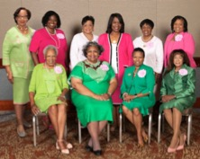
Chapter Basileus Certification Committee
Chenita Daughtry
North Atlantic
Carla Archie
Mid Atlantic
Cleola Michelle Pringle
South Atlantic
Rhonda Taliafero
Great Lakes
Charlotte Anderson
South Eastern
Jacqueline Dansby
South Central
Mildred Edwards
Mid Western
Dorothy J. Smith
Far Western
Caroline L. Lattimore Resource
Martha L. Perine Beard
Directorate Liaison
Chief of Staff to the Supreme Basileus

